Slide 1
Credit Risk
based on
Hull
Chapter 26

Slide 2
Overview
Estimation of default probabilities
Reducing credit exposure
Credit Ratings Migration
Credit Default Correlation
Credit Value-at-Risk Models

Slide 3
Sources of Credit Risk for FI
Potential defaults by:
  Borrowers
  Counterparties in derivatives transactions
  (Corporate and Sovereign) Bond issuers
Banks are motivated to measure and manage Credit Risk.
Regulators require banks to keep capital reflecting the credit risk they bear (Basel II).

Slide 4
Ratings
In the S&P rating system, AAA is the best rating. After that comes AA, A, BBB, BB, B, and CCC.
The corresponding Moody’s ratings are Aaa, Aa, A, Baa, Ba, B, and Caa.
Bonds with ratings of BBB (or Baa) and above are considered to be “investment grade”.

Slide 5
Spreads of investment grade zero-coupon bonds: features
Baa/BBB
Spread over Treasuries
A/A
Aa/AA
Aaa/AAA
Maturity
Notes:
Spread over treasury zero-curve increases as rating declines. It also increases with maturity. Spread tends to increase faster with maturity for low credit ratings than for high credit ratings. Example: the difference between the five year spread and the one year spread for a BBB-rated bond is greater than that for a AAA-rated bond.

Slide 6
Expected Default Losses on Bonds
Comparing the price of a corporate bond with the price of a risk free bond.
Common features must be:
  Same maturity
  Same coupon
Assumption: PV of cost of defaults equals
(P of risk free bond – P of corporate bond)
Example
Notes:
Show Example from Hull (p. 612) for one year bonds.

Slide 7
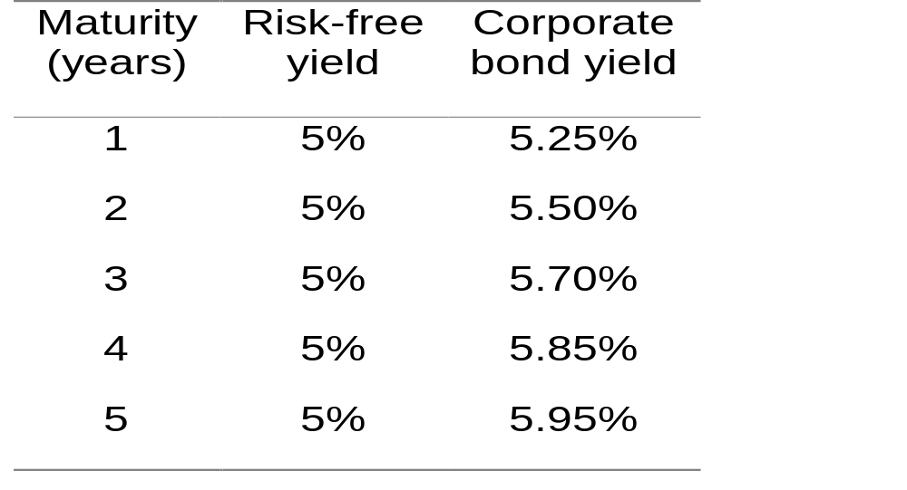
Example: Data
According to Hull most analysts use the LIBOR rate as risk free rate.

Slide 8
Probability of Default (PD)
PD assuming no recovery:
  y(T): yield on T-year corporate zero bond.
  y*(T): yield on T-year risk free zero bond.
  Q(T): Probability that corporation will default between time zero and time T.
{Q(T) x 0 + [1-Q(T)] x 100}e^-y*(T)T
Main Result: Q(T)=1-e^-[y(T)-y*(T)]T
Notes:
Demonstration of example 26.1. on page 613.

Slide 9
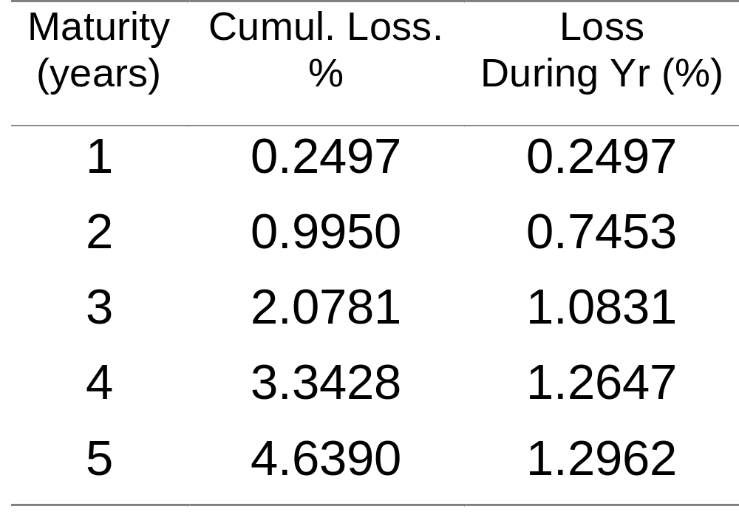
Results
Notes:
Example 26.1 at page 613: Default probabiilty between years.

Slide 10
Hazard rates
Two ways of quantifying PD
  Hazard rates h(t):
  h(t)δt equals PD between t and t+δt conditional on no earlier default
  Default probability density q(t):
  q(t)δt equals unconditional probability of default between t and t+δt
Notes:
Examples p. 614; timeline.

Slide 11
Recovery Rates
Definition:
  Proportion R of claimed amount received in the event of a default.
  Some claims have priorities over others and are met more fully.
Start with Assumptions:
  Claimed amount equals no-default value of bond → calculation of PD is simplified.
  Zero-coupon Corporate Bond prices are either observable or calculable.
Notes:
I would like to show how to get equation 26.2. on page 615 in Hull.

Slide 12
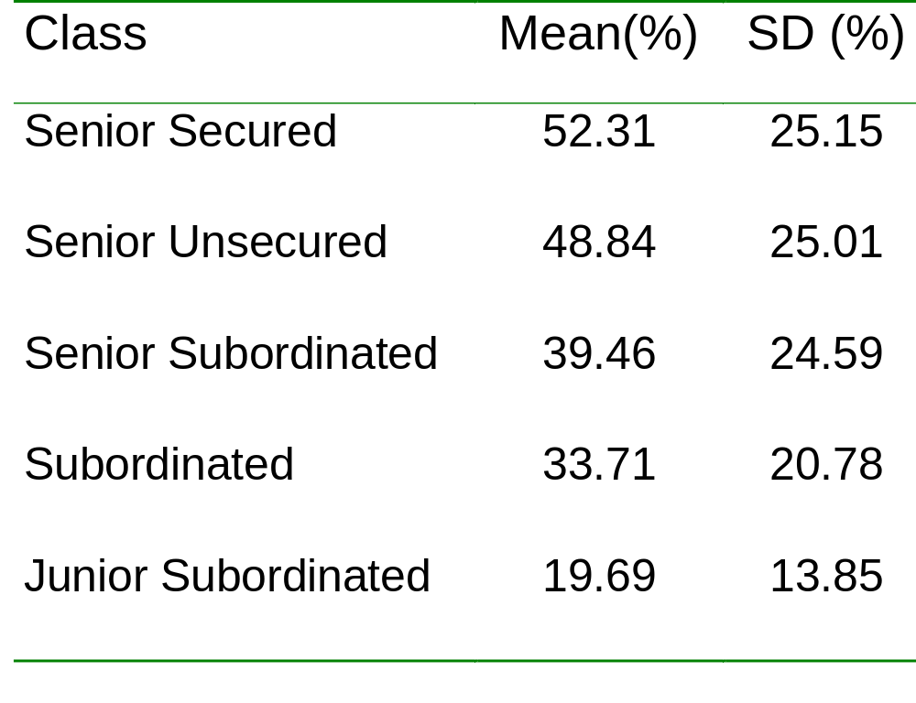
Amounts recovered on Corporate Bonds (% of par)
Data: Moody´s Investor Service (Jan 2000), cited in Hull on page 614.

Slide 13
More realistic assumptions
Claim made in event of default equals
  Bond´s face value plus
  Accrued interest
PD must be calculated from coupon bearing Corporate Bond prices, not zero-coupon bond prices.
Task: Extract PD from coupon-bearing bonds for any assumptions about claimed amount.
Notes:
Show example/derivation starting on page 615

Slide 14
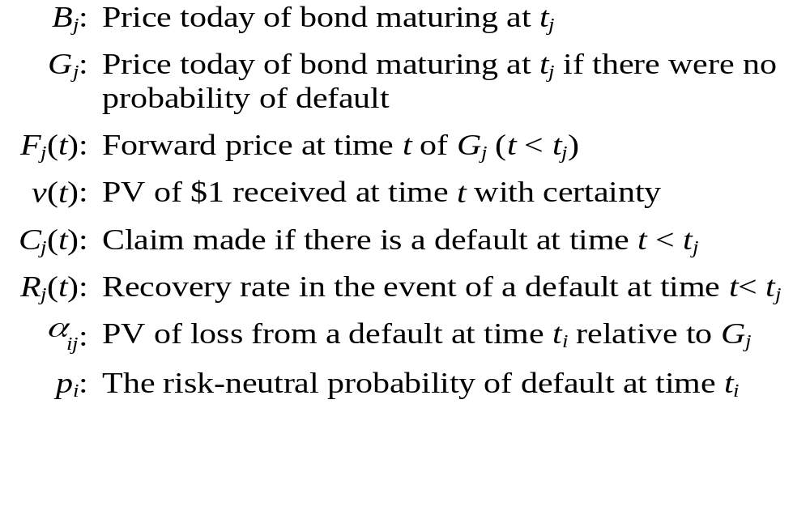
Notation

Slide 15
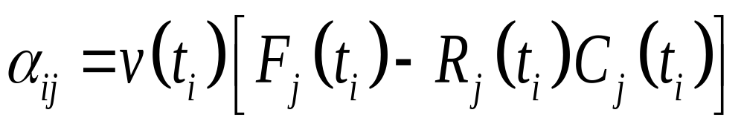
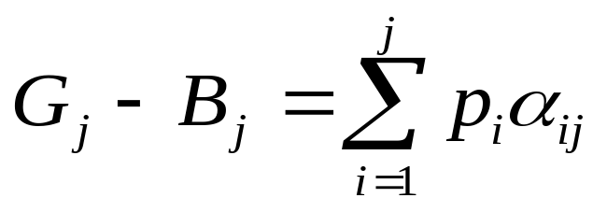
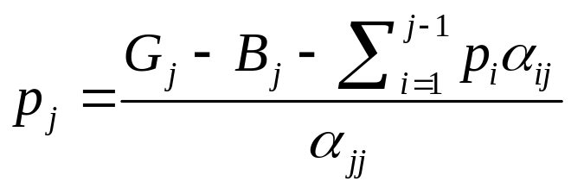
Risk-Neutral Probability of Default
PV of loss from default
Reduction in bond price due to default
Computing p’s inductively
Notes:
Assumptions:
There are N coupon bearing bonds issued by a corporation being considered or by comparable corp that has roughly same pd at all future dates.
Defaults can happen on any of the maturity dates.
Interest rates are deterministic, Recovery rates and claim amounts are known with certainty.
Show Solution to problem 26.6 from assignment part, explained on page 616.
This analysis assumes constant interest rates, and known recovery rates and claim amounts
If default events, risk-free rates, and recovery rates are independent, results hold for stochastic interest rates, and uncertain recovery rates providing the recovery rate is set equal to its expected value in a risk-neutral world,
Show what happens when default can happen at any time p. 617: formulas using integrals and default probability density q(t).

Slide 16
Claim amounts and value additivity
If Claim amount = no default value of bond →
value of coupon bearing bonds equals sum of values of underlying zero-coupon bonds.
If Claim amount = FV of bond plus accrued interest, value additivity does not apply.

Slide 17
Asset Swaps
An asset swap exchanges the return on a bond for a spread above LIBOR.
Asset swaps are frequently used to extract default probabilities from bond prices. The assumption is that LIBOR is the risk-free rate.

Slide 18
Asset Swaps: Example 1
An investor owns a 5-year corporate bond worth par that pays a coupon of 6%. LIBOR is flat at 4.5%. An asset swap would enable the coupon to be exchanged for LIBOR plus 150bps
In this case B_{j}=100 and G_{j}=106.65 (The value of 150 bps per year for 5 years is 6.65.)
Notes:
Use equations 26.4 and 26.5 on page 616/617 to estimate default probabilities.

Slide 19
Asset Swap: Example 2
Investor owns a 5-year bond is worth $95 per $100 of face value and pays a coupon of 5%. LIBOR is flat at 4.5%.
The asset swap would be structured so that the investor pays $5 upfront and receives LIBOR plus 162.79 bps. ($5 is equivalent to 112.79 bps per year)
In this case B_{j}=95 and G_{j}=102.22 (162.79 bps per is worth $7.22)
Notes:
In theory asset swap spreads should be slightly dependent on the bond’s coupon
In practice it is assumed to be the same for all bonds with a particular maturity and the quoted asset swap spread is assume to apply to a bond selling for par
This means that the spread would be quoted as 162.79 bps in Example 2 and when calculating default probabilities we would assume B_{j}=100 and G_{j}=107.22

Slide 20
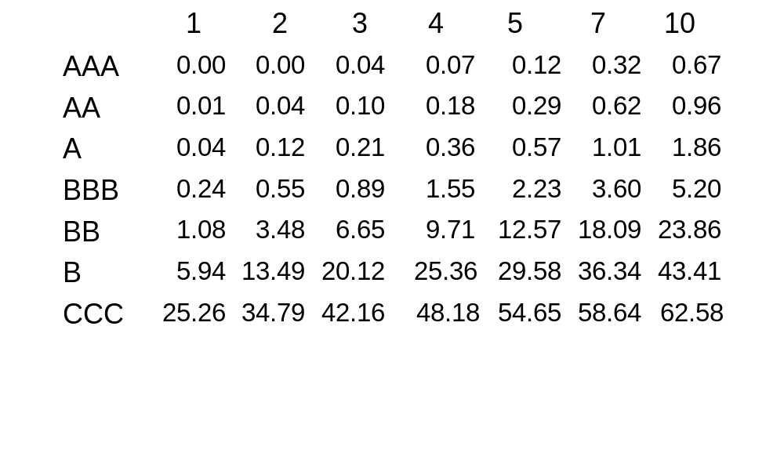
Historical Data
Historical data provided by rating agencies are also used to estimate the probability of default
Notes:
The table shows the probability of default for companies starting with a particular credit rating
A company with an initial credit rating of BBB has a probability of 0.24% of defaulting by the end of the first year, 0.55% by the end of the second year, and so on
For a company that starts with a good credit rating default probabilities tend to increase with time
For a company that starts with a poor credit rating default probabilities tend to decrease with time

Slide 21
Bond Prices vs. Historical Default Experience
The estimates of the probability of default calculated from bond prices are much higher than those from historical data
Consider for example a 5 year A-rated zero-coupon bond
This typically yields at least 50 bps more than the risk-free rate
Notes:
Show example on page 620 oben

Slide 22
Possible Reasons for These Results
The liquidity of corporate bonds is less than that of Treasury bonds.
Bonds traders may be factoring into their pricing depression scenarios much worse than anything seen in the last 20 years.

Slide 23
A Key Theoretical Reason
The default probabilities estimated from bond prices are risk-neutral default probabilities.
The default probabilities estimated from historical data are real-world default probabilities.

Slide 24
Risk-Neutral Probabilities
The analysis based on bond prices assumes that
The expected cash flow from the A-rated bond is 2.47% less than that from the risk-free bond.
The discount rates for the two bonds are the same. This is correct only in a risk-neutral world.
Notes:
Example

Slide 25
The Real-World Probability of Default
The expected cash flow from the A-rated bond is 0.57% less than that from the risk-free bond
But we still get the same price if we discount at about 38 bps per year more than the risk-free rate
If risk-free rate is 5%, it is consistent with the beta of the A-rated bond being 0.076

Slide 26
Using equity prices to estimate default probabilities
Merton’s model regards the equity as an option on the assets of the firm.
In a simple situation the equity value is
E(T)=max(V_{T} - D, 0)
where V_{T} is the value of the firm and D is the debt repayment required.

Slide 27
Merton´s model
E
D
D
D
A
A
Strike=Debt
Equity interpreted as long call on firm´s asset value.
Debt interpreted as combination of short put and riskless bond.
Notes:
Show example in Excel!

Slide 28
Using equity prices to estimate default probabilities
Black-Scholes give value of equity today as:
E(0)=V(0)xN(d1)-De^(-rT)N(d2)
From Ito´s Lemma:
σ(E)E(0)=(δE/δV)σ(V)V(0)
Equivalently σ(E)E(0)=N(d1)σ(V)V(0)
Use these two equations to solve for V(0) and σ(V,0).

Slide 29
Using equity prices to estimate default probabilities
The market value of the debt is therefore
  V(0)-E(0)
Compare this with present value of promised payments on debt to get expected loss on debt:
(PV(debt)-V(Debt Merton))/PV(debt)
Comparing this with PD gives expected recovery in event of default.
Notes:
Name and emphasize problems of Mertons approach. Show Excel file example.

Slide 30
The Loss Given Default (LGD)
LGD on a loan made by FI is assumed to be
V-R(L+A)
Where
  V: no default value of the loan
  R: expected recovery rate
  L: outstanding principal on loan/FV bond
  A: accrued interest

Slide 31
LGD for derivatives
For derivatives we need to distinguish between
  a) those that are always assets,
  b) those that are always liabilities, and
  c) those that can be assets or liabilities
What is the loss in each case?
  a) no credit risk
  b) always credit risk
  c) may or may not have credit risk

Slide 32
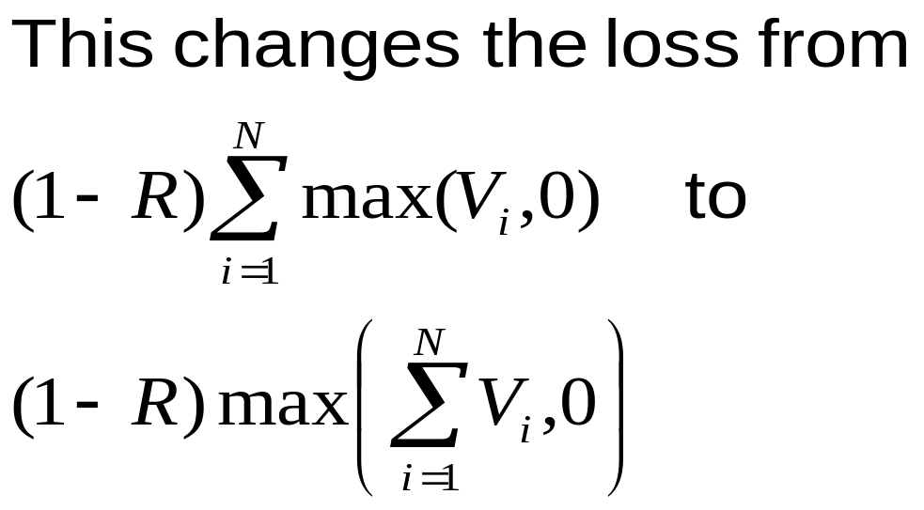
Netting
Netting clauses state that is a company defaults on one contract it has with a financial institution it must default on all such contracts.
Notes:
Value of option on portfolio <= value of corresponding portfolio of options

Slide 33
Reducing Credit Exposure
Collateralization
Downgrade triggers
Diversification
Contract design
Credit derivatives
Notes:
P 625

Slide 34
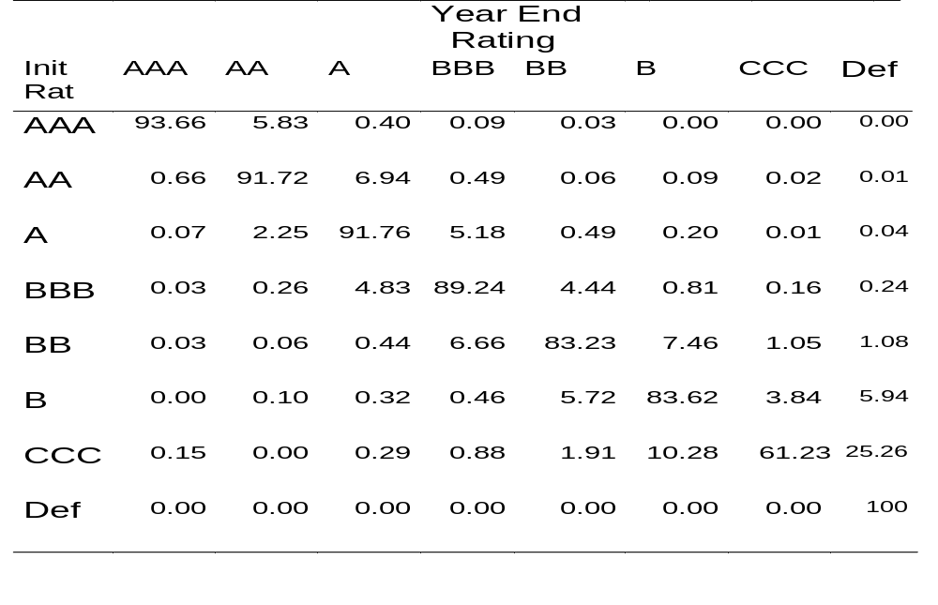
Credit Ratings Migration
Source: Hull, p. 626, whose source is S&P, January 2001
Notes:
Show example related to credit rating migration

Slide 35
Risk-Neutral Transition Matrix
A risk-neutral transition matrix is necessary to value derivatives that have payoffs dependent on credit rating changes.
A risk-neutral transition matrix can (in theory) be determined from bond prices.

Slide 36
Example
Suppose there are three rating categories and risk-neutral default probabilities extracted from bond prices are:
Cumulative probability of default
1 2 3 4 5
A 0.67% 1.33% 1.99% 2.64% 3.29%
B 1.66% 3.29% 4.91% 6.50% 8.08%
C 3.29% 6.50% 9.63% 12.69% 15.67%

Slide 37
Matrix Implied
Default Probability
Let M be the annual rating transition matrix and d_{i} be the vector containing probability of default within i years
d₁ is the rightmost column of M
d_{i} = M d_{i-1} = M^{i-1} d₁
Number of free parameters in M is number of ratings squared

Slide 38
Transition Matrix Consistent With Default Probabilities
A B C Default
A 98.4% 0.9% 0.0% 0.7%
B 0.5% 97.1% 0.7% 1.7%
C 0.0% 0.0% 96.7% 3.3%
Default 0.0% 0.0% 0.0% 100%
This is chosen to minimize difference between all elements of M^{i-1} d₁ and the corresponding cumulative default probabilities implied by bond prices.

Slide 39
Credit Default Correlation
The credit default correlation between two companies is a measure of their tendency to default at about the same time
Default correlation is important in risk management when analyzing the benefits of credit risk diversification
It is also important in the valuation of some credit derivatives

Slide 40
Measure 1
One commonly used default correlation measure is the correlation between
  A variable that equals 1 if company A defaults between time 0 and time T and zero otherwise
  A variable that equals 1 if company B defaults between time 0 and time T and zero otherwise
The value of this measure depends on T. Usually it increases at T increases.

Slide 41
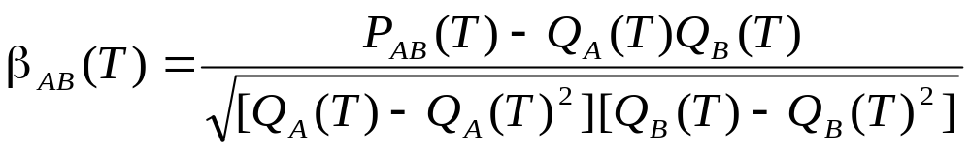
Measure 1 continued
Denote Q_{A}(T) as the probability that company A will default between time zero and time T, Q_{B}(T) as the probability that company B will default between time zero and time T, and P_{AB}(T) as the probability that both A and B will default. The default correlation measure is

Slide 42
Measure 2
Based on a Gaussian copula model for time to default.
Define t_{A} and t_{B} as the times to default of A and B
The correlation measure, ρ_{AB} , is the correlation between
u_{A}(t_{A})=N⁻¹[Q_{A}(t_{A})]
and
u_{B}(t_{B})=N⁻¹[Q_{B}(t_{B})]
where N is the cumulative normal distribution function

Slide 43
Use of Gaussian Copula
The Gaussian copula measure is often used in practice because it focuses on the things we are most interested in (Whether a default happens and when it happens)
Suppose that we wish to simulate the defaults for n companies . For each company the cumulative probabilities of default during the next 1, 2, 3, 4, and 5 years are 1%, 3%, 6%, 10%, and 15%, respectively

Slide 44
Use of Gaussian Copula continued
We sample from a multivariate normal distribution for each company incorporating appropriate correlations
N ⁻¹(0.01) = -2.33, N ⁻¹(0.03) = -1.88,
N ⁻¹(0.06) = -1.55, N ⁻¹(0.10) = -1.28,
N ⁻¹(0.15) = -1.04

Slide 45
Use of Gaussian Copula continued
When sample for a company is less than
-2.33, the company defaults in the first year
When sample is between -2.33 and -1.88, the company defaults in the second year
When sample is between -1.88 and -1.55, the company defaults in the third year
When sample is between -1,55 and -1.28, the company defaults in the fourth year
When sample is between -1.28 and -1.04, the company defaults during the fifth year
When sample is greater than -1.04, there is no default during the first five years

Slide 46
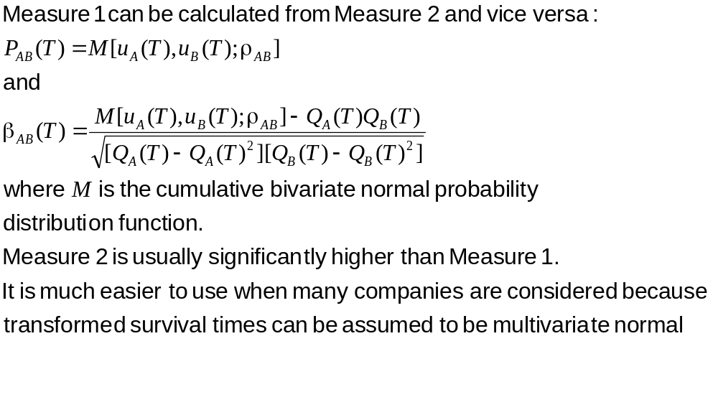
Measure 1 vs Measure 2

Slide 47
Modeling Default Correlations
Two alternatives models of default correlation are:
Structural model approach
Reduced form approach

Slide 48
Structural Model Approach
Merton (1974), Black and Cox (1976), Longstaff and Schwartz (1995), Zhou (1997) etc
Company defaults when the value of its assets falls below some level.
The default correlation between two companies arises from a correlation between their asset values

Slide 49
Reduced Form Approach
Lando(1998), Duffie and Singleton (1999), Jarrow and Turnbull (2000), etc
Model the hazard rate as a stochastic variable
Default correlation between two companies arises from a correlation between their hazard rates

Slide 50
Pros and Cons
Reduced form approach can be calibrated to known default probabilities. It leads to low default correlations.
Structural model approach allows correlations to be as high as desired, but cannot be calibrated to known default probabilities.

Slide 51
Credit VaR
Credit VaR asks a question such as:
What credit loss are we 99% certain will not be exceeded in 1 year?

Slide 52
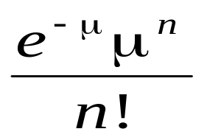
Basing Credit VaR on Defaults Only (CSFP Approach)
When the expected number of defaults is μ, the probability of n defaults is
This can be combined with a probability distribution for the size of the losses on a single default to obtain a probability distribution for default losses

Slide 53
Enhancements
We can assume a probability distribution for μ.
We can categorize counterparties by industry or geographically and assign a different probability distribution for expected defaults to each category



Slide 54
Model Based on Credit Rating Changes (Creditmetrics)
A more elaborate model involves simulating the credit rating changes in each counterparty.
This enables the credit losses arising from both credit rating changes and defaults to be quantified

Slide 55
Correlation between Credit Rating Changes
The correlation between credit rating changes is assumed to be the same as that between equity prices
We sample from a multivariate normal distribution and use the result to determine the rating change (if any) for each counterparty

